Slide 1

Page Object Model in selenium

Slide 2
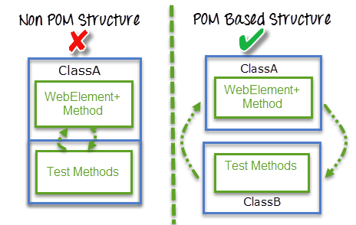
Introduction
Page Object Model is a design pattern to create Object Repository for web UI elements.
Under this model, for each web page in the application, there should be corresponding page class.
This Page class will find the WebElements of that web page and also contains Page methods which perform operations on those WebElements.
Name of these methods should be given as per the task they are performing.
‘Page Object Model’ is a way of representing an application in a test framework.

Slide 3
Benefits of POM
The benefits of Page object Model are:-
Code reusability – We could achieve code reusability by writing the code once and use it in different tests.
Code maintainability – There is a clean separation between test code and page specific code such as locators and layout which becomes very easy to maintain code. Code changes only on Page Object Classes when a UI change occurs. It enhances test maintenance and reduces code duplication.
Object Repository – Each page will be defined as a java class. All the fields in the page will be defined in an interface as members. The class will then implement the interface.
Readability – Improves readability due to clean separation between test code and page specific code

Slide 4
Procedure to implement POM
Step 1) Create a ‘New Package‘ file and name it as ‘pageObjects’, by right click on the Project and select New > Package.
Step 2) Create a ‘New Class‘ file and refer the name to the actual page from the test object, by right click on the above created Package and select New > Class. In our case it is Home Page and LogIn Page.
Step 3)Now create a Static Method for each Element (Object) in the Home Page. Each method will have an Argument (driver) and a Return value (element).
Driver is being passed as an Argument so that Selenium is able to locate the element on the browser (driver).
Element is returned, so that an Action can be performed on it.
Method is declared as Public Static, so that it can be called in any other method without instantiate the class.

Slide 5
Now see the code for Home Page here:-
package pageObjects;
import org.openqa.selenium.By;
import org.openqa.selenium.WebDriver;
import org.openqa.selenium.WebElement;
public class Home_Page {
private static WebElement element = null;
public static WebElement lnk_MyAccount(WebDriver driver){
element = driver.findElement(By.id("account"));
return element;
}
public static WebElement lnk_LogOut(WebDriver driver){
element = driver.findElement(By.id("account_logout"));
return element;
}
}

Slide 6
Now see the code for Login Page here:-
package pageObjects;
import org.openqa.selenium.*;
import org.openqa.selenium.WebDriver;
import org.openqa.selenium.WebElement;
public class LogIn_Page {
private static WebElement element = null;
public static WebElement txtbx_UserName(WebDriver driver){
element = driver.findElement(By.id("log"));
return element;
}
public static WebElement txtbx_Password(WebDriver driver){
element = driver.findElement(By.id("pwd"));
return element;
}
public static WebElement btn_LogIn(WebDriver driver){
element = driver.findElement(By.id("login"));
return element;
}
}

Slide 7
Step 4)Create a ‘New Class‘ and name it as POM_TC by right click on the ‘automationFramework‘ Package and select New > Class.Under this package,creating all test cases.
package automationFramework;
import java.util.concurrent.TimeUnit;
import org.openqa.selenium.WebDriver;
import org.openqa.selenium.firefox.FirefoxDriver;
import pageObjects.Home_Page;
import pageObjects.LogIn_Page;
public class POM_TC {
private static WebDriver driver = null;
public static void main(String[ ] args) {
driver = new FirefoxDriver();
driver.manage().timeouts().implicitlyWait(10, TimeUnit.SECONDS);
driver.get(“URL");
// Use page Object library now
Home_Page.lnk_MyAccount(driver).click();
LogIn_Page.txtbx_UserName(driver).sendKeys("testuser_1");

Slide 8
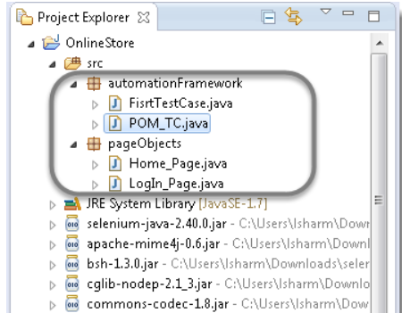
Now see Project explorer window look like this:-
LogIn_Page.txtbx_Password(driver).sendKeys("Test@123");
LogIn_Page.btn_LogIn(driver).click();
System.out.println(" Login Successfully, now it is the time to Log Off buddy.")
Home_Page.lnk_LogOut(driver).click();
driver.quit();
}}

Slide 9
Covered Till Now
Page Object Model is an Object Repository design pattern in Selenium WebDriver.
The benefits of Page object Model are:-
Code reusability
Code maintainability
Object Repository
Readability

Slide 10
Thanks

